Slide 1


Introduction to Git and GitHub

Slide 2
Table of contents.
Problem formulation (A simple HTML page)
Introduction to Git and GitHub
Things you can do with Git/Github
Creating a repository
Add-commit-push
Making changes locally
Cloning a repository
Making changes in the web app
Pulling the changes to the local repository
Show changes between 2 versions
Restore to older versions (version control)

Slide 3

What is Git?
Created by Linus Torvalds, April 2005
Software for tracking changes in a set of files
Version Control System (VCS)
Distributed version control
Open source, free
Used for coordinating work between multiple programmers

Slide 4

What Is Version Control?
Helps developers track and manage changes to a software project code.
Lets developers safely work through branching and merging.
Keeps track of every modification to the code.
Lets you to revert your project back to an older version.

Slide 5

What is GitHub?
A web-based interface that uses Git.
Provides access control and several collaboration features
Offers the distributed version control and source code management (SCM) functionality of Git
If you have open-source projects that use Git, then GitHub is designed to help you better manage them.
Code Hosting platform

Slide 6
Benefits of using Git/Github
It helps to keep the track of the code history
GitHub is a place where project managers and developers come together to coordinate, track, and update their work so that projects are transparent and stay on schedule.
All the code and documentation are in one place. There are millions of repositories on GitHub, and each repository has its own tools to help you host and release code.
Collaborating is smoother and consumes lesser time.

Slide 7
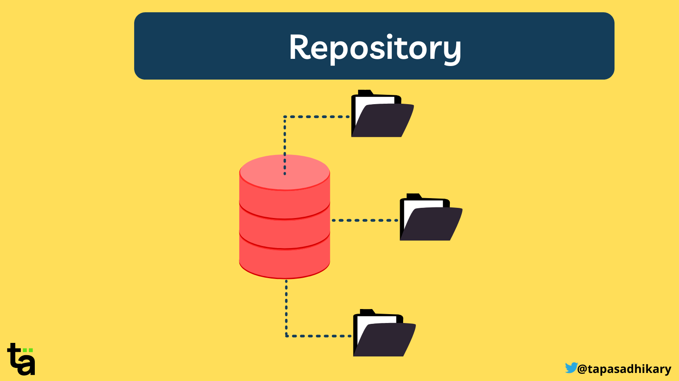
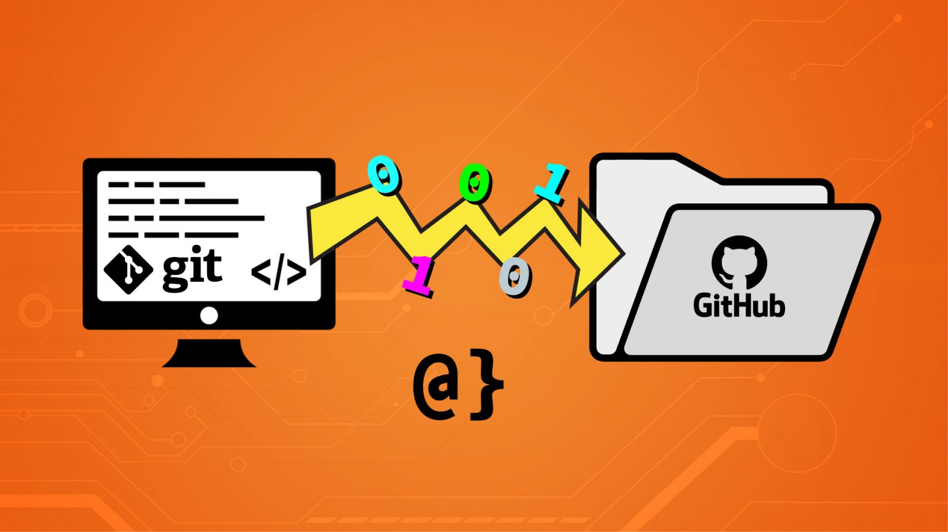
What is a repository?
A central location in which data is stored and managed.
Usually used to organize a single project
A repository contains all of your project's files and each file's revision history. You can discuss and manage your project's work within the repository.

Slide 8
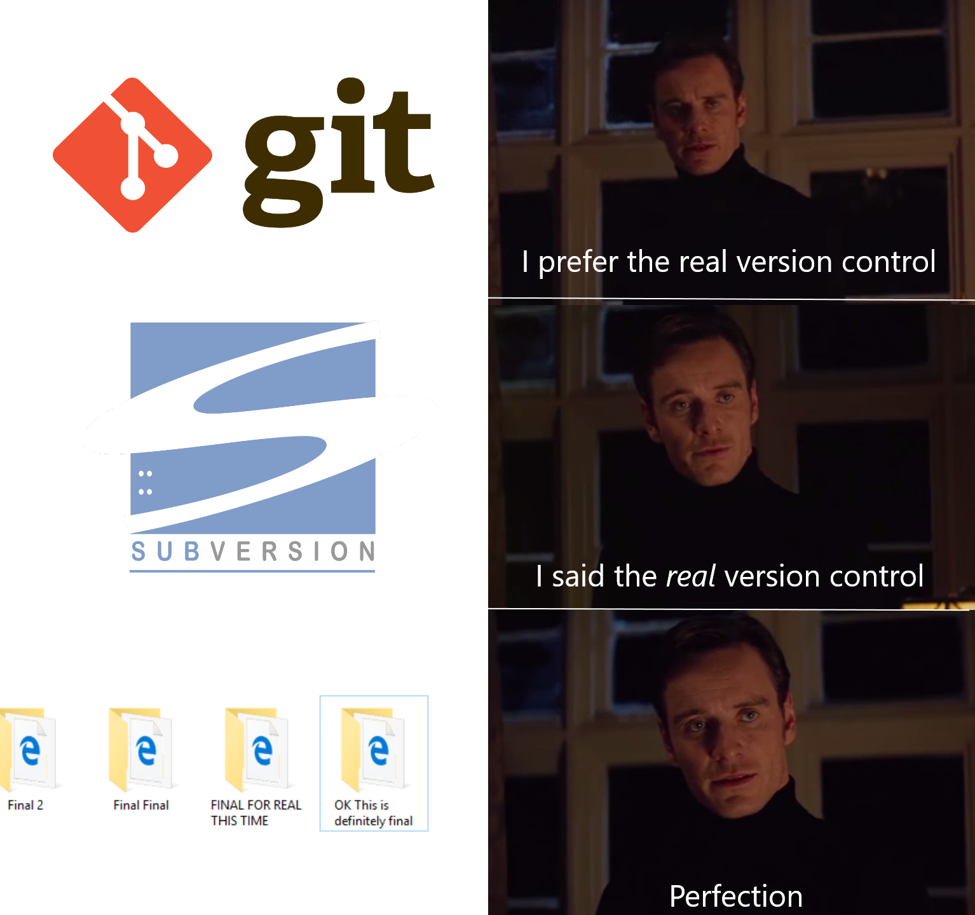

Slide 9
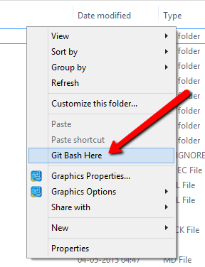
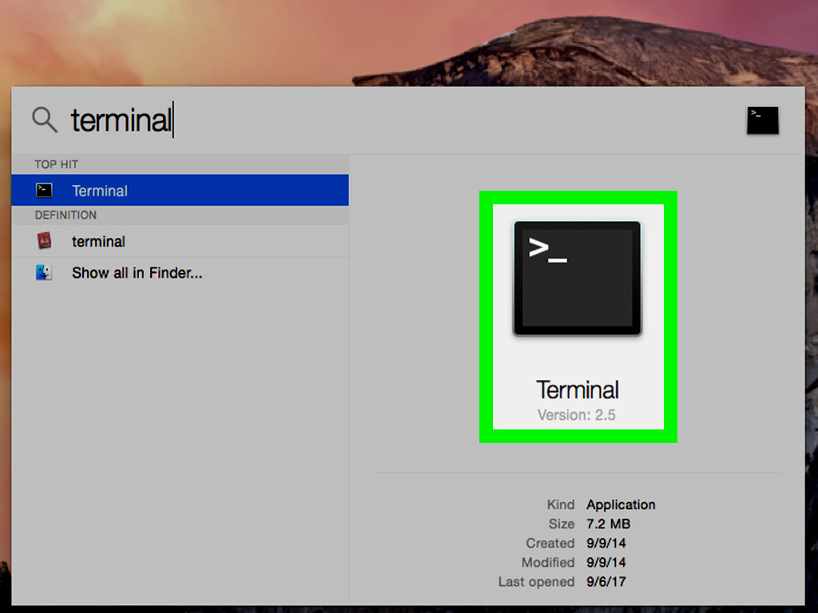
Open Git Bash / Terminal

Slide 10
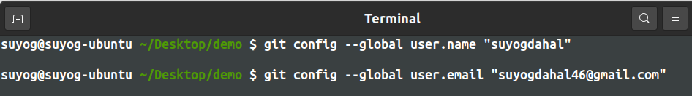
Configuration
You typically configure your global username and email address after installing Git.

Slide 11
$ git init
The git init command is used to generate a new, empty Git repository or to reinitialize an existing one. It creates a new .git folder that contains all of the necessary Git metadata for the new repository.

Slide 12
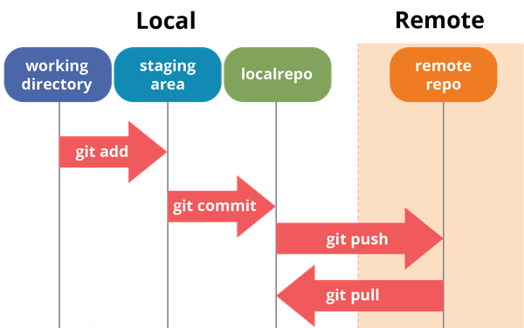
Git Workflow

Slide 13
Git follows following three tree architecture:
Working – is the directory where the file changes are made.
Staging – before the work has been committed to repository the changes are prepared for commit and sits in a staging index. Imagine a box. You can put stuff into the box. You can take stuff out of the box. This box is the staging area of Git. You can craft commits here. Committing is like sealing that box and sticking a label on it. The contents of that box are your changes.
Local Repository – once the changes are staged these can be committed to repository that is in your local machine.

Slide 14
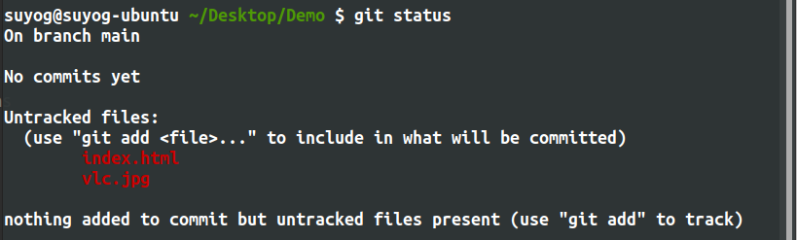
$ git status
displays the state of the working directory and the staging area.

Slide 15
States that file can be in
Untracked means Git found a file you didn’t have in previous commit.
Modified means that we have changed the contents of file but still not committed on our local repo.
Staged means that the modified is added to the staging area and is ready to go into next commit.
Committed means that data is safely stored in local repo.

Slide 16
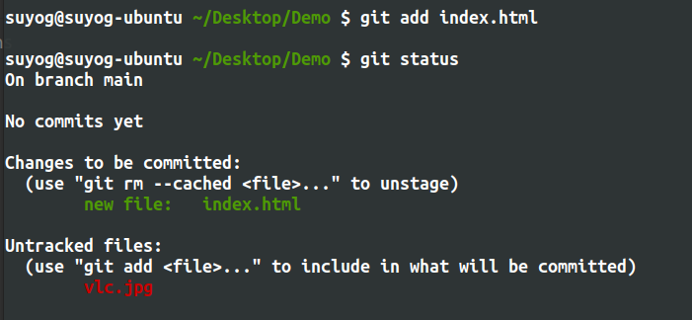
$ git add <filepath>
This command tells Git to start tracking file by adding them to staging area.

Slide 17
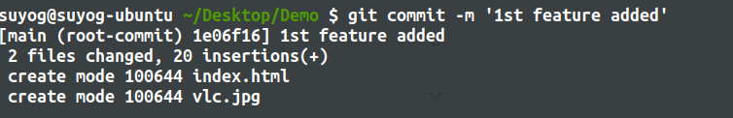
$ git commit -m “message”
The git commit command captures a snapshot of the project's currently staged changes. Committed snapshots can be thought of as “safe” versions of a project—Git will never change them unless you explicitly ask it to..

Slide 18


Slide 19
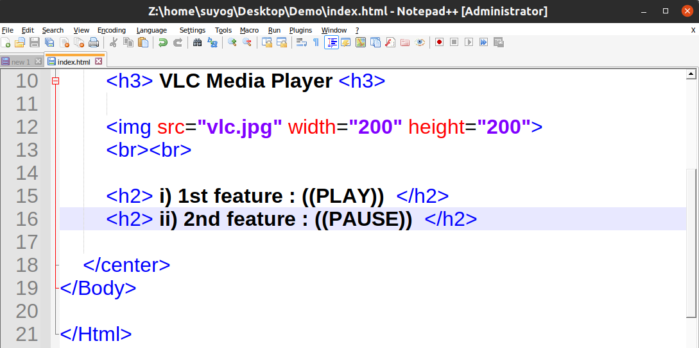
Make changes locally
Adding another feature feature 2

Slide 20
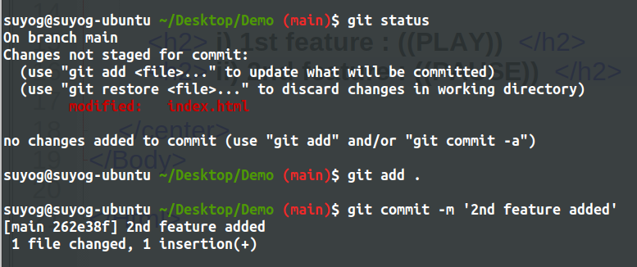
Add and commit feature 2

Slide 21
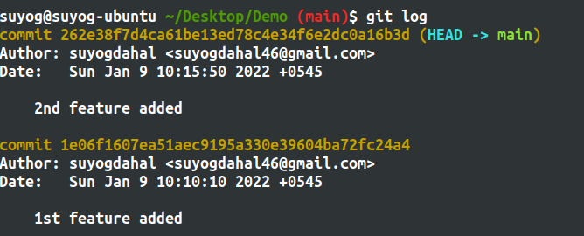
$ git log
It shows a list of all the commits made to a repository. You can see the hash of each Git commit, the message associated with each commit, and more metadata. This command is useful for displaying the history of a repository.

Slide 22
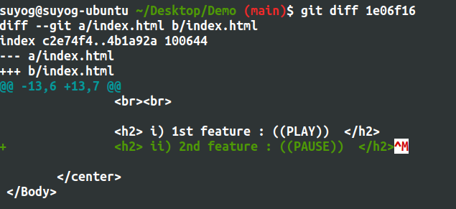
$ git diff
Displays the differences between 2 files.

Slide 24
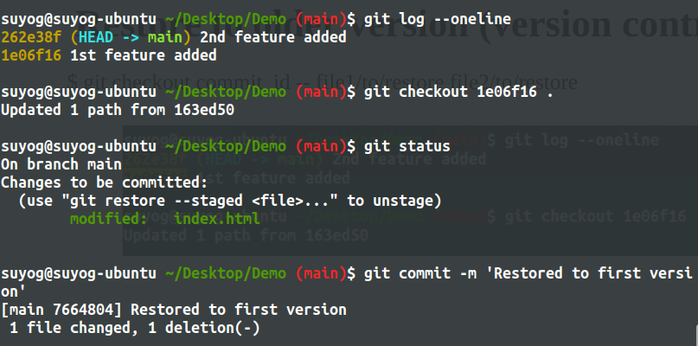
Restore to older version (version control)
$ git checkout commit_id -- file1/to/restore file2/to/restore

Slide 25


Slide 26
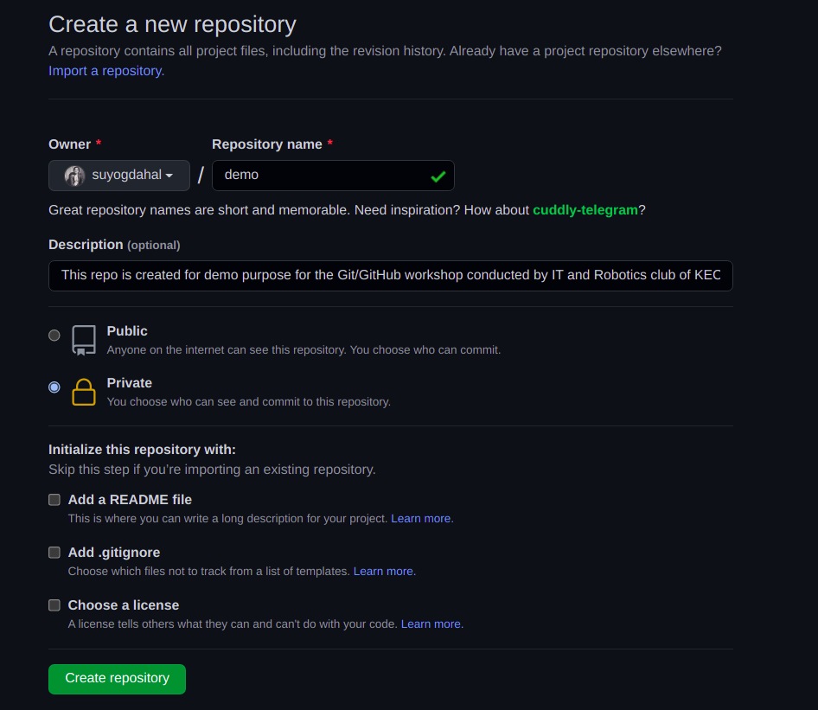
Create a GitHub Repository

Slide 27
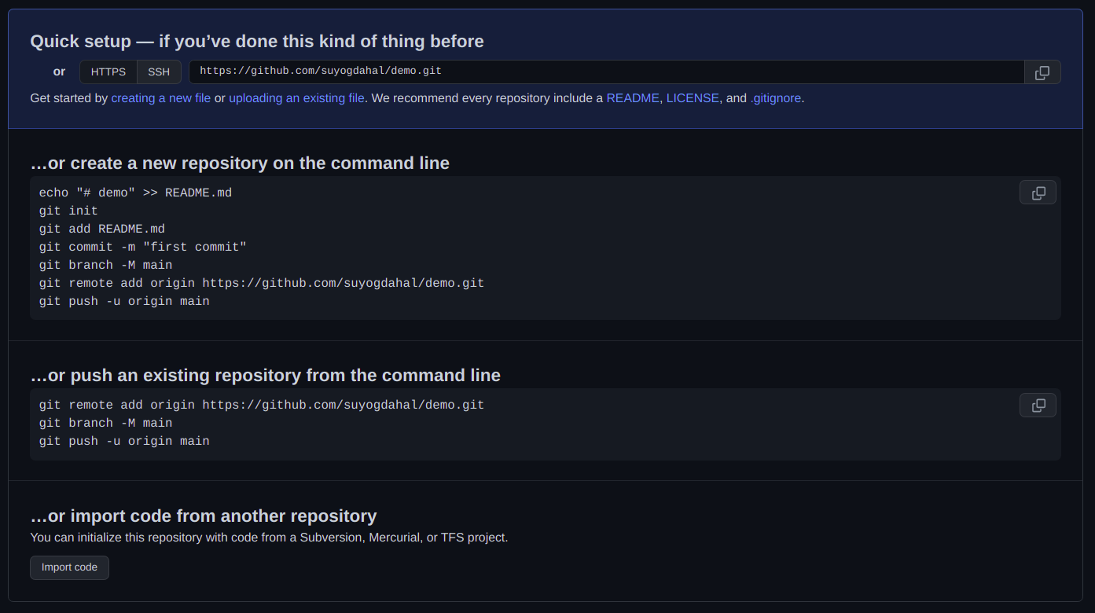
Follow the steps to push local repo to remote

Slide 28
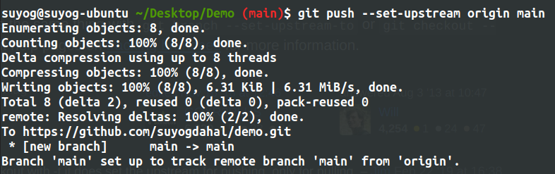
$ git push -u <remote_repo> <branch>
Git push is used for pushing contents of local repo to remote repo i.e GitHub

Slide 29
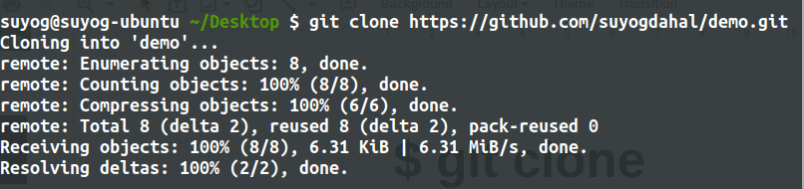
$ git clone
Cloning the remote repo to local.

Slide 30
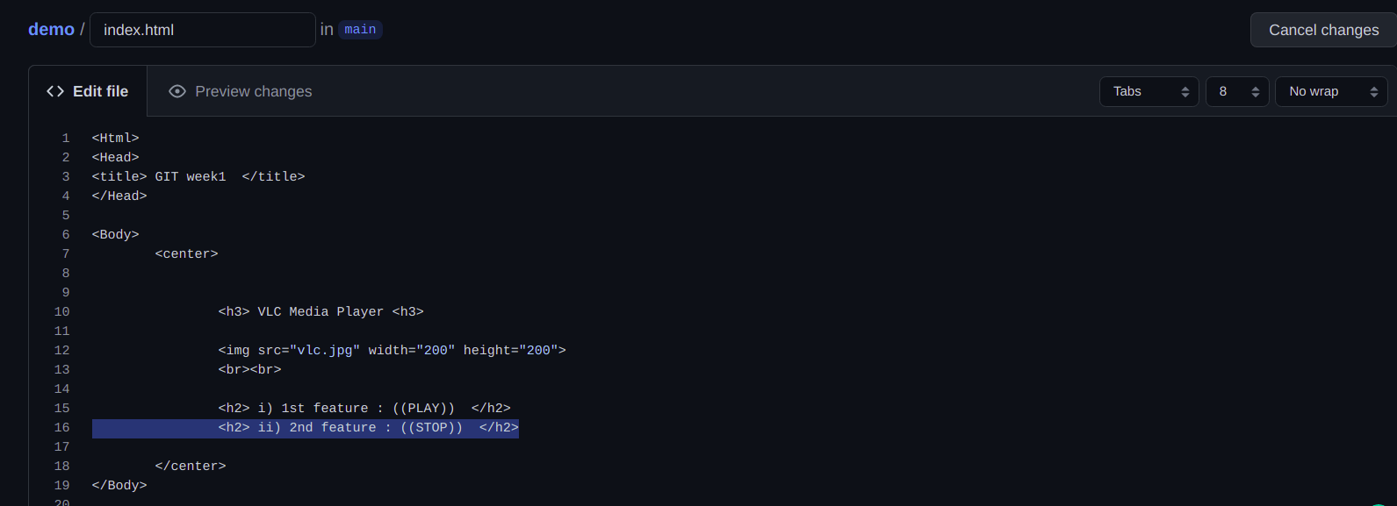
Making changes in the github website

Slide 31
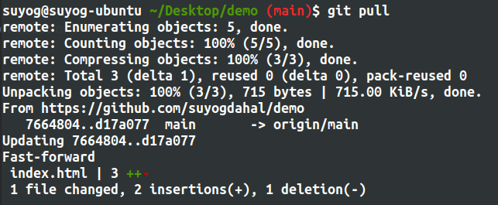
$ git pull
Pull the changes from the remote repo (github) to the local repo.

Slide 32
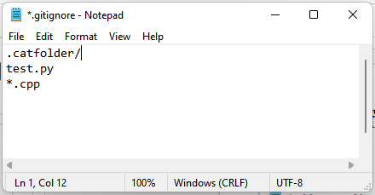
.gitignore file
The gitignore file is a file that tells git which files not to track (exclude) in the project

Slide 33
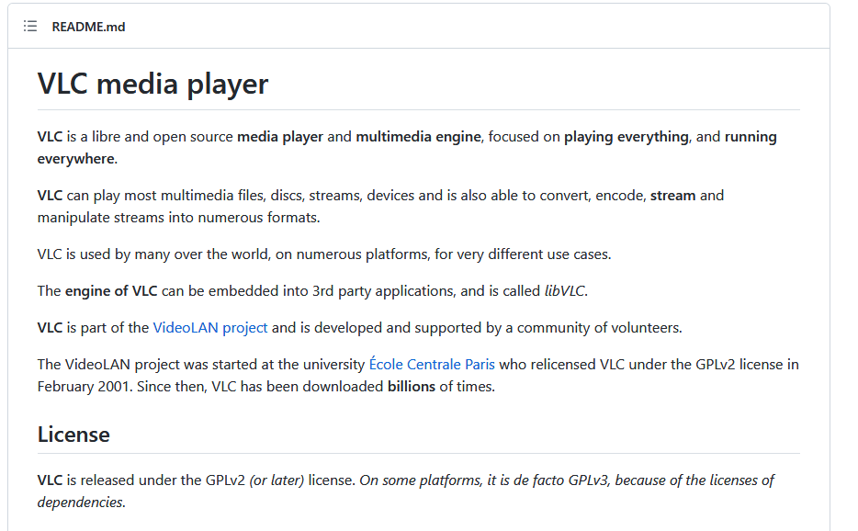
README.md
Document written in markdown language that describes the repository.

Slide 34

Assignment
For any one of your project written in any programming language, push it to a new github repository.
If you’re facing any difficulties:
Contact us at:
Facebook: Kec I.T. Club
Mail: kecktm.it.club@gmail.com

